Slide 1
DBSCAN Clustering

Slide 2
DBSCAN Clustering
Appropriate to use when examine spatial data

Slide 3
Density-based clustering
Spherical-shape clusters
Arbitrary-shape clusters

Slide 4
K-means Vs. Density-based clustering
K-means assigns all points to a cluster even if they do not belong in any
Density-based clustering locates regions of high density, and separates outliers
Algorithm has no notion about outliers

Slide 5
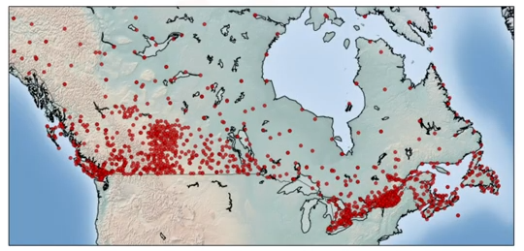
DBSCAN for class identification
Effective for tasks like class identification on a spatial context. It can find out any arbitrary shaped cluster without getting effected by noise.
this map show the location of weather stations in Canada

Slide 6
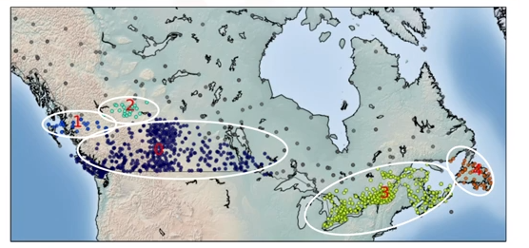
DBSCAN for class identification

Slide 7
What is DBSCAN?
DBSCAN (Density Based Spatial Clustering of Applications with noise
Is one of the most common clustering algorithms
Works based on density of objects
R (Radius of neighborhood)
Radius (R) that if includes enough number of points within, we call it a dense area
M (Min number of neighbors)
The minimum number of data points we want in a neighborhood to define a cluster

Slide 8
How DBSCAN Works
R = 2unit , M =6

Slide 9
How DBSCAN Works
R = 2unit , M =6
Core point: a data point is a core point if within our neighborhood of the point, there are at least M points. Ex. There are 6 points in the 2cm neighbor of the red point. We mark this point as a core point.

Slide 10
How DBSCAN Works
R = 2unit , M =6
Border point: A data point is a border point if
Its neighborhood contains less than M data points
Its is reachable from some core point (Ex. In our case, yellow is within 2cm neighborhood of the red point)

Slide 11
How DBSCAN Works
R = 2unit , M =6
Border point: A data point is a border point if
Its neighborhood contains less than M data points
Its is reachable from some core point (Ex. In our case, yellow is within 2cm neighborhood of the red point)

Slide 12
DBSCAN algorithm - outliers
R = 2unit , M =6
Outlier: is a point that is not a core point and also not close enough to be reachable from the core point.
We continue and visit all the points in the dataset and label them as either core, border or outlier.
Then connect core points that are neighbors and put them in the same clusters. Thus, a cluster is formed as at least one core point plus all reachable core points plus all their borders.

Slide 13
Advantages of DBSCAN
R = 2unit , M =6
Arbitrary shaped clusters
Robust to outliers
Does not require specification of the number of clusters

